Slide 1
Module 3: Operating-System Structures
System Components
Operating System Services
System Calls
System Programs
System Structure
Virtual Machines
System Design and Implementation
System Generation

Slide 2
Common System Components
Process Management
Main Memory Management
Secondary-Storage Management
I/O System Management
File Management
Protection System

Slide 3
Process Management
A process is a program in execution. A process needs certain resources, including CPU time, memory, files, and I/O devices, to accomplish its task.
The operating system is responsible for the following activities in connection with process management.
  Process creation and deletion.
  process suspension and resumption.

Slide 4
Main-Memory Management
Memory is a large array of words or bytes, each with its own address. It is a repository of quickly accessible data shared by the CPU and I/O devices.
Main memory is a volatile storage device. It loses its contents in the case of system failure.
The operating system is responsible for the following activities in connections with memory management:
  Keep track of which parts of memory are currently being used and by whom.
  Decide which processes to load when memory space becomes available.
  Allocate and deallocate memory space as needed.

Slide 5
Secondary-Storage Management
Since main memory (primary storage) is volatile and too small to accommodate all data and programs permanently, the computer system must provide secondary storage to back up main memory.
Most modern computer systems use disks as the principle on-line storage medium, for both programs and data.
The operating system is responsible for the following activities in connection with disk management:
  Free space management
  Storage allocation
  Disk scheduling

Slide 6
I/O System Management
The I/O system consists of:
  A buffer-caching system
  A general device-driver interface
  Drivers for specific hardware devices

Slide 7
File Management
A file is a collection of related information defined by its creator. Commonly, files represent programs (both source and object forms) and data.
The operating system is responsible for the following activities in connections with file management:
  File creation and deletion.
  Directory creation and deletion.
  Support of primitives for manipulating files and directories.
  Mapping files onto secondary storage.
  File backup on stable (nonvolatile) storage media.

Slide 8
Protection System
Protection refers to a mechanism for controlling access by programs, processes, or users to both system and user resources.
The protection mechanism must:
  distinguish between authorized and unauthorized usage.
  provide a means of enforcement.

Slide 9
Networking (Distributed Systems)
A distributed system is a collection processors that do not share memory or a clock. Each processor has its own local memory.
The processors in the system are connected through a communication network.
A distributed system provides user access to various system resources.
Access to a shared resource allows:
  Computation speed-up
  Increased data availability
  Enhanced reliability

Slide 10
Command-Interpreter System
Many commands are given to the operating system by control statements which deal with:
  process creation and management
  I/O handling
  secondary-storage management
  main-memory management
  file-system access
  protection
  networking

Slide 11
Command-Interpreter System (Cont.)
The program that reads and interprets control statements is called variously:
  control-card interpreter
  command-line interpreter
  shell (in UNIX)
Its function is to get and execute the next command statement.

Slide 12
Operating System Services
Program execution – system capability to load a program into memory and to run it.
I/O operations – since user programs cannot execute I/O operations directly, the operating system must provide some means to perform I/O.
File-system manipulation – program capability to read, write, create, and delete files.
Communications – exchange of information between processes executing either on the same computer or on different systems tied together by a network. Implemented via shared memory or message passing.
Error detection – ensure correct computing by detecting errors in the CPU and memory hardware, in I/O devices, or in user programs.

Slide 13
Additional Operating System Functions
Additional functions exist not for helping the user, but rather for ensuring efficient system operations.
  Resource allocation – allocating resources to multiple users or multiple jobs running at the same time.
  Accounting – keep track of and record which users use how much and what kinds of computer resources for account billing or for accumulating usage statistics.
  Protection – ensuring that all access to system resources is controlled.

Slide 14
System Calls
System calls provide the interface between a running program and the operating system.
  Generally available as assembly-language instructions.
  Languages defined to replace assembly language for systems programming allow system calls to be made directly (e.g., C. Bliss, PL/360)
Three general methods are used to pass parameters between a running program and the operating system.
  Pass parameters in registers.
  Store the parameters in a table in memory, and the table address is passed as a parameter in a register.
  Push (store) the parameters onto the stack by the program, and pop off the stack by operating system.
  Exp: Read a data from one file and copy them to another file.

Slide 15
Type of System Calls
Process Control
File Management
Device Management
Information maintenance

Slide 16
Passing of Parameters As A Table

Slide 17
MS-DOS Execution
At System Start-up
Running a Program

Slide 18
UNIX Running Multiple Programs

Slide 19
Communication Models
Msg Passing
Shared Memory

Slide 20
System Programs
System programs provide a convenient environment for program development and execution. This can be divided into:
  File manipulation
  Status information
  File modification
  Programming language support
  Program loading and execution
  Communications
  Application programs
Most users’ view of the operation system is defined by system programs, not the actual system calls.

Slide 21
System Call Vs System Program
System program: These are the programs that are used and required to run the system - machine, input output devices and other connected peripherals.
System program maybe is simple library function, like sins, cons.
They are also known as System softwares.
System calls: System calls, are the calls made by the applications or the processors for a particular execution of a code block.
System call will cause CPU running level switch, from user level to kernel level
They are also known as interrupts in computer.

Slide 22
System Structure – Simple Approach
MS-DOS – written to provide the most functionality in the least space
  not divided into modules
  Although MS-DOS has some structure, its interfaces and levels of functionality are not well separated

Slide 23
MS-DOS Layer Structure

Slide 24
System Structure – Simple Approach (Cont.)
UNIX – limited by hardware functionality, the original UNIX operating system had limited structuring. The UNIX OS consists of two separable parts.
  Systems programs
  The kernel
    Consists of everything below the system-call interface and above the physical hardware
    Provides the file system, CPU scheduling, memory management, and other operating-system functions; a large number of functions for one level.

Slide 25
UNIX System Structure

Slide 26
System Structure – Layered Approach
The operating system is divided into a number of layers (levels), each built on top of lower layers. The bottom layer (layer 0), is the hardware; the highest (layer N) is the user interface.
With modularity, layers are selected such that each uses functions (operations) and services of only lower-level layers.

Slide 27
An Operating System Layer

Slide 28
Layered Structure of the THE OS
A layered design was first used in THE operating system.
Its six layers are as follows:

Slide 29
OS/2 Layer Structure

Slide 30
Virtual Machine
A Virtual Machine is a software that creates a virtualized environment between the computer platform and the end user in which the end user can operate software.

Slide 31
Description
A virtual machine provides an interface identical to the underlying hardware.
The operating system creates the illusion of multiple processes, each executing on its own processor with its own (virtual) memory.

Slide 32
Desktop Virtualization Architecture
V i r t u a l
Applications
Applications
Applications
Guest OS
(Windows)
Guest OS
(Linux)
Guest OS
(VMware ESX)
Virtual Machine
Virtual Machine
Virtual Machine
P h y s i c a l
Virtual Machine Manager
Host OS
Hardware

Slide 33
Virtualization
Virtualization is an abstraction layer that decouples the physical hardware from the operating system to deliver greater IT resource utilization and flexibility.
It allows multiple virtual machines, with heterogeneous operating systems to run in isolation, side-by-side on the same physical machine.

Slide 34
Virtualization contd..
Each virtual machine has its own set of virtual hardware (e.g., RAM, CPU, NIC, etc.) upon which an operating system and applications are loaded.
The operating system creates the illusion of multiple processes, each executing on its own processor with its own (virtual) memory.

Slide 35
Virtual Machine Monitor
The host software that provides virtualization is often referred to as a virtual machine monitor (VMM) or hypervisor.
The VMM gives each virtual machine an illusion of a complete computer to itself.

Slide 37
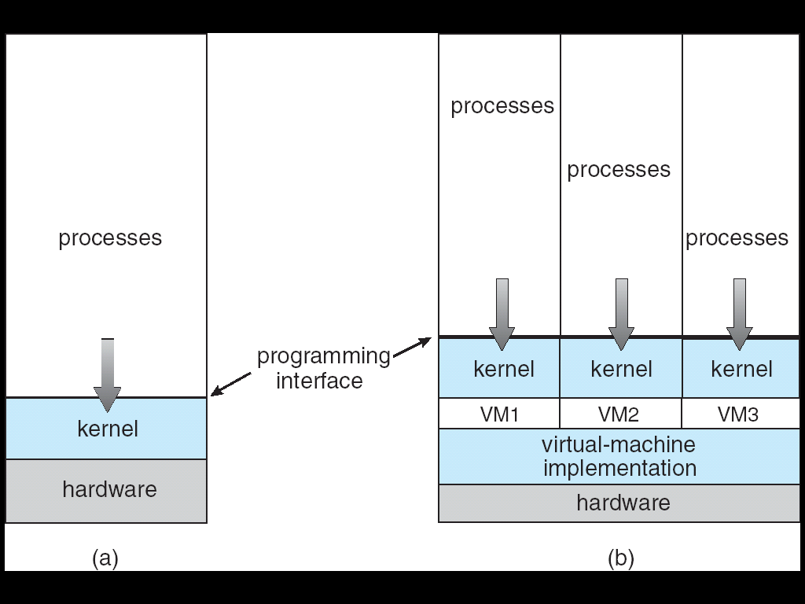
Architecture

Slide 38
Benefits
1. Partitioning
- Multiple applications and operating systems can be supported within a single physical system.
- There is no overlap amongst memory as each Virtual Memory has its own memory space.

Slide 39
Benefits
2.Isolation
-Virtual machines are completely isolated from the host machine and other virtual machines. If a virtual machine crashes, all others are unaffected.
-Data does not leak across virtual machines.

